Slide 1



SMART INDIA HACKATHON 2026
TITLE PAGE
Problem Statement ID – SIH26161
Problem Statement Title-
Dam Break Inundation Modelling using Hydrodynamic Modelling of any River
Theme- Disaster Management
PS Category- Software
Team ID-
Team Name - NIYANTA

Slide 2


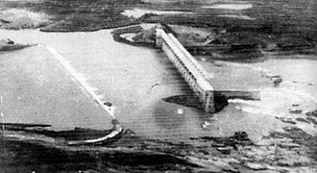
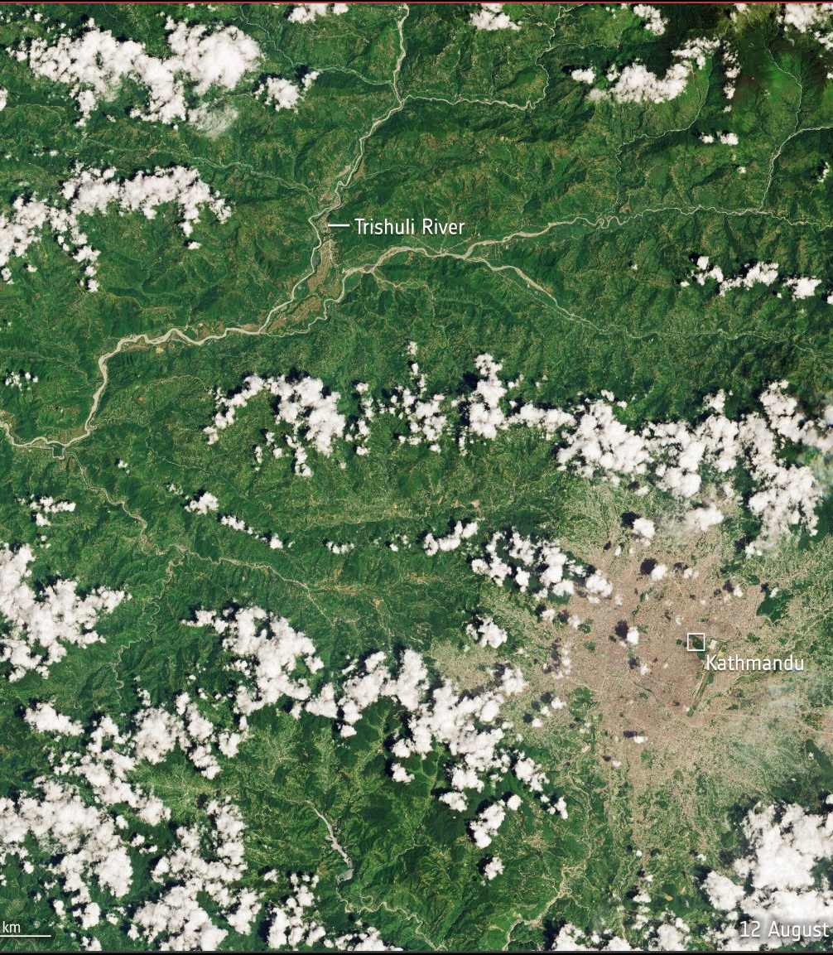
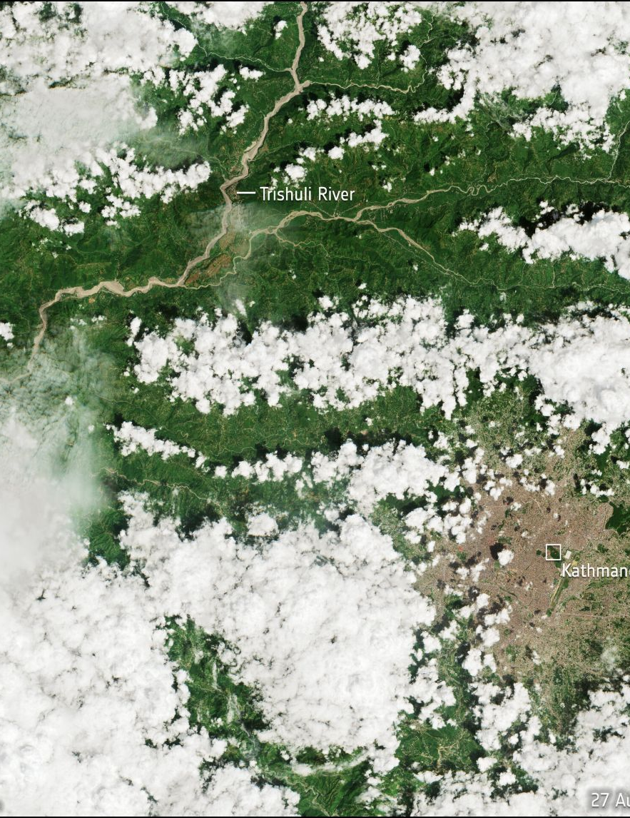
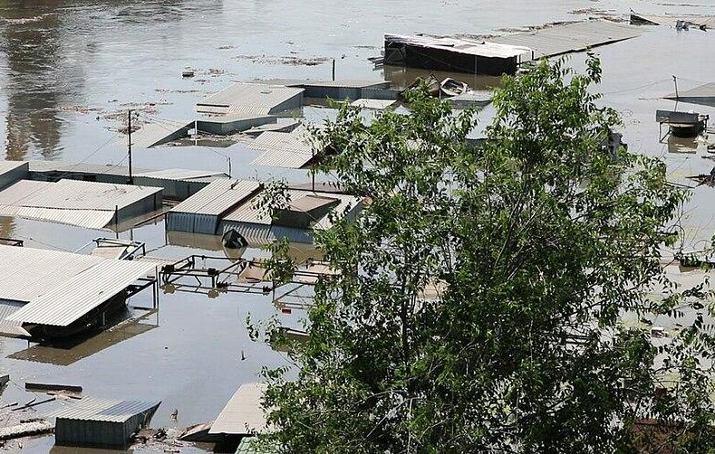
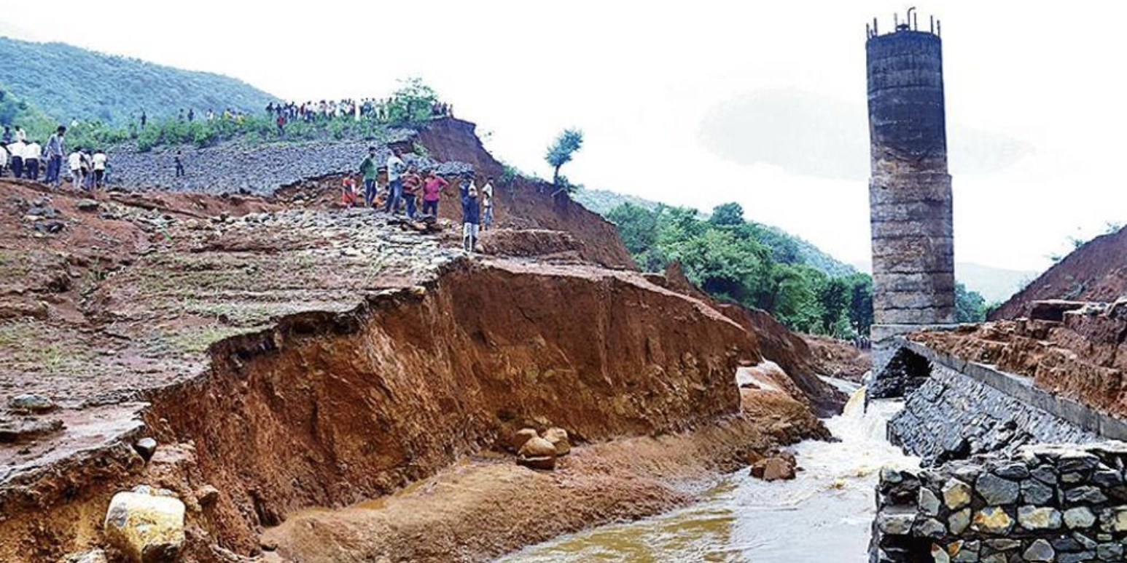
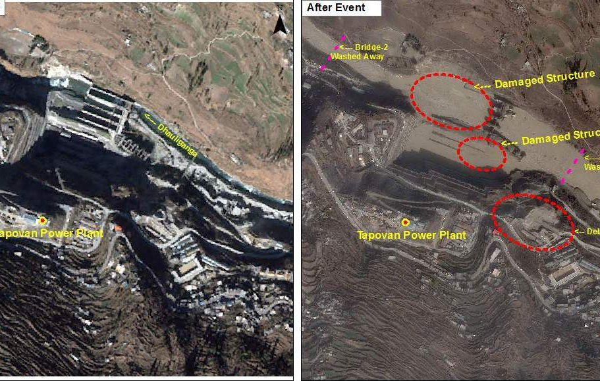
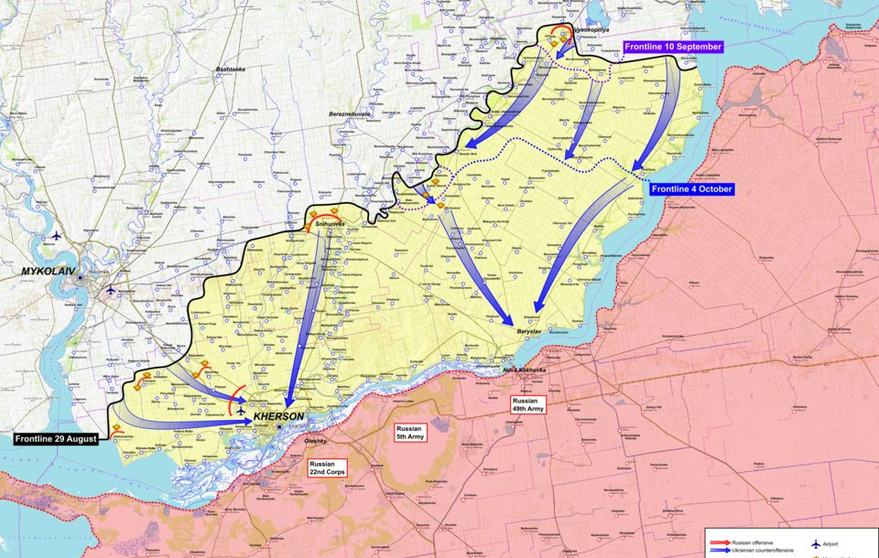



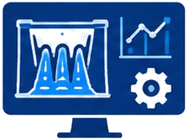



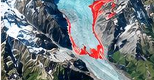

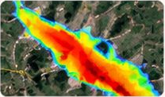


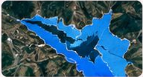
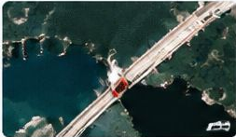
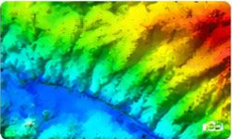

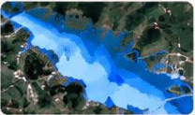



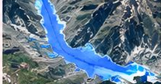
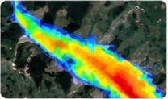
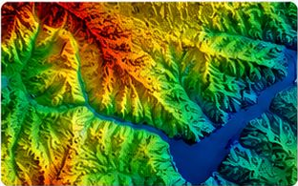

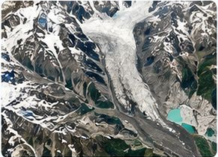
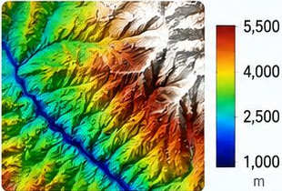




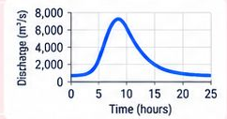
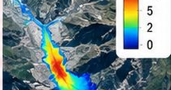


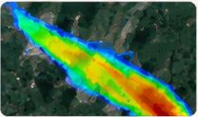

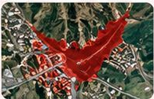
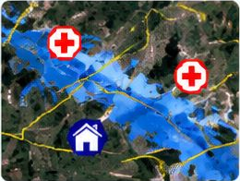
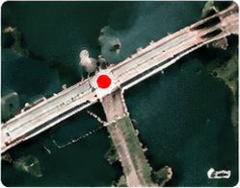

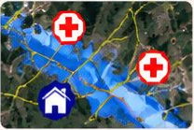

NIYANTA
IDEA TITLE
NIYANTA - Intelligence that guides action. We treat this problem statement as three different real-world scenarios.
01
DAM CRITICALITY
02
NATURAL EXTREME EVENT
03
HUMAN / WARTIME TRIGGER
High inflow
12 AUG
27 AUG
Weather change
Ukraine 2023
Deliberate attack
Storage increase
Glacier / ice-rock change
Sudden release
Machhu Dam II (Gujarat, India, 1979)
Overtopping
2026_Nepal_Tibet_floods
Natural blockage
Destruction_of_the_Kakhovka_Dam
Dam breach
Failed dam
Sudden release
Flood wave
Flood consequences
Flash flood
Downstream flooding
Tiware Dam (Maharashtra, India – 2019)
Rishiganga, Uttarakhand 2021
The Dnieper River was the frontline.
OUR SOLUTION FOR THIS CASE
OUR SOLUTION FOR THIS CASE
(Case 02 – Natural Extreme Event)
OUR SOLUTION FOR THIS CASE
(Case 03 – Human / Wartime Trigger)
Input data (X₁)
f₁(X₁)
Output (Y₁)
Input data (X₂)
f₂(X₂)
Output (Y₂)
Input data (X₃)
f₃(X₃)
Output (Y₃)
Breach / overflow risk
Change map
(glacier / terrain)
Scenario
generation
Inundation
probability map
Flood extent (map)
Risk indication
Google
Earth Engine
Copernicus
Sentinel
Dam /
reservoir
Flood extent map
Google
Earth Engine
Copernicus
Sentinel
Dam /
reservoir
Google
Earth Engine
Copernicus
Sentinel-1/2
Open-
Meteo
Reservoir
condition analysis
+
Breach risk
estimation
Depth & velocity
Change detection
+
Event risk
assessment
Possible event
scenario
Hydrodynamic
simulation
Depth & velocity
Satellite imagery
(pre / current)
DEM
(SRTM / ALOS)
Arrival time
Flood extent (map)
Population &
critical infra
Breach
scenario
Impact
assessment
Arrival time
DEM
(Cartosat / SRTM / GLO-30)
Historical
records
Affected population
& infrastructure
Glacier / terrain
(Sentinel-2)
DEM
(GLO-30 / SRTM)
Depth & arrival time
Affected population
& infrastructure
SEE OUR WORKING DEMO (YouTube ↗)
SEE OUR WORKING DEMO (YouTube ↗)
SEE OUR WORKING DEMO (YouTube ↗)

Slide 3
















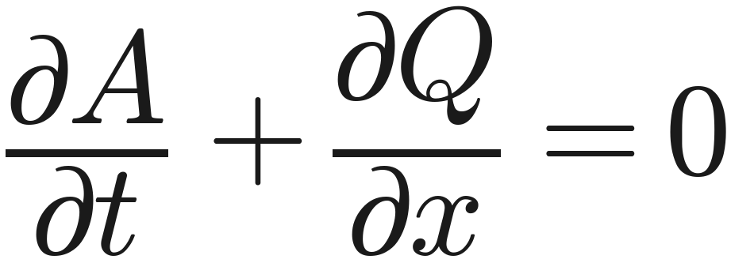
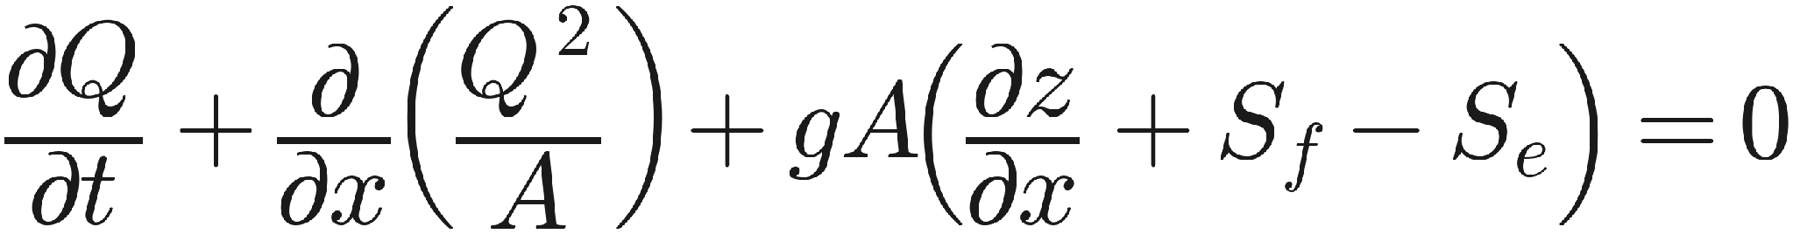





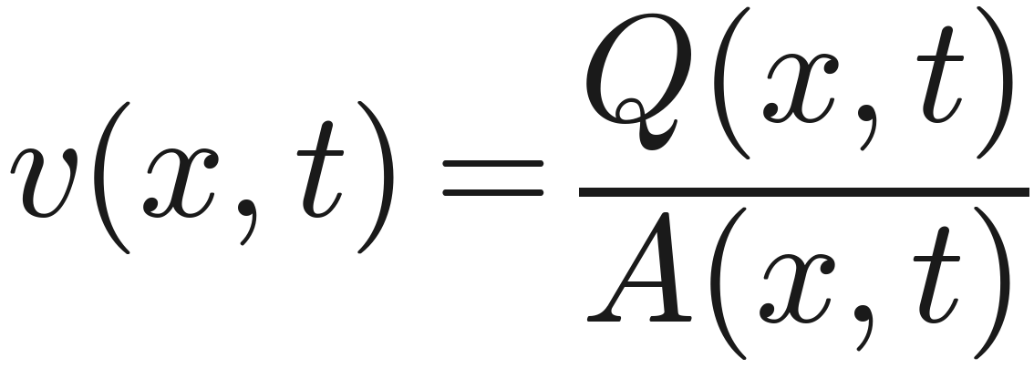
NIYANTA
TECHNICAL APPROACH
Technical Workflow - Three data streams → one common computational engine → advance flood outputs
INPUT LAYER
ALGORITHM / COMPUTATION LAYER
OUTPUT LAYER
1
Dam / Reservoir Inputs
India-WRIS (reservoir level)
Flood Inundation Map
(extent)
IMD / ERA5 (inflow, rainfall)
Breach Model
Breach Outflow
Hydrodynamic Solver
Empirical methods
Hydrograph Q_{b}(t)
Dam geometry (CWC/WRIS)
HEC-RAS
Depth Map
d(x, t)
SRTM / Cartosat DEM
Froehlich (2008)
(1D/2D)
Froehlich (1995)
Historical records
Von Thun & Gillette
Q (m³/s)
Delft3D/ANUGA
Xu & Zhang
(2D/3D)
Velocity Map
v(x, t)
Scenario Spec
MacDonald & Langridge
2
Natural Event Inputs
B
t (hours)
SPH
Breach type & location
d
(fast simulation)
Sentinel-1 SAR (GEE)
B, D, T_{b}, initial level
Flood Hydrograph
Q vs t
Sentinel-2 (Cartosat/Landsat)
Inflow / boundary conditions
Glacier segmentation (AI)
DEM / river geometry
Governing Equations (1D Saint-Venant)
Roughness / land cover
Continuity (Mass Conservation)
Momentum Conservation
SRTM / Cartosat / ALOS DEM
Arrival Time
T_{arrival} (key locations)
IMD / ERA5 (rainfall, snow, LST)
Seismic data (NCS/USGS)
Affected Population
(WorldPop / Census)
A : flow area (m²)
Q : discharge (m³/s)
g : gravitational acceleration
t : time (s)
z : water surface elevation
3
Human / Wartime Inputs
x : distance (m)
S_{f} : friction slope
S_{e} : energy slope (bed slope)
Infrastructure Impact
(OSM)
Pre/Post imagery (Sentinel-1/2)
Flood-Wave Propagation
Damage assessment data
Compute H(x, t), Q(x, t), depth, velocity and arrival time
Dam geometry (CWC/WRIS)
Depth
Velocity
Arrival Time
Reports & GIS Export
(GeoTIFF, SHP, KML, PDF)
SRTM / Cartosat DEM
OSM / WorldPop / field data

Slide 4
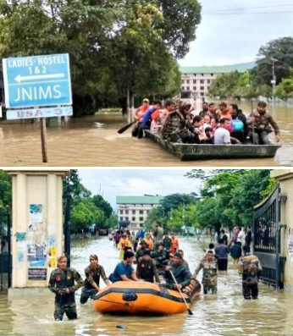





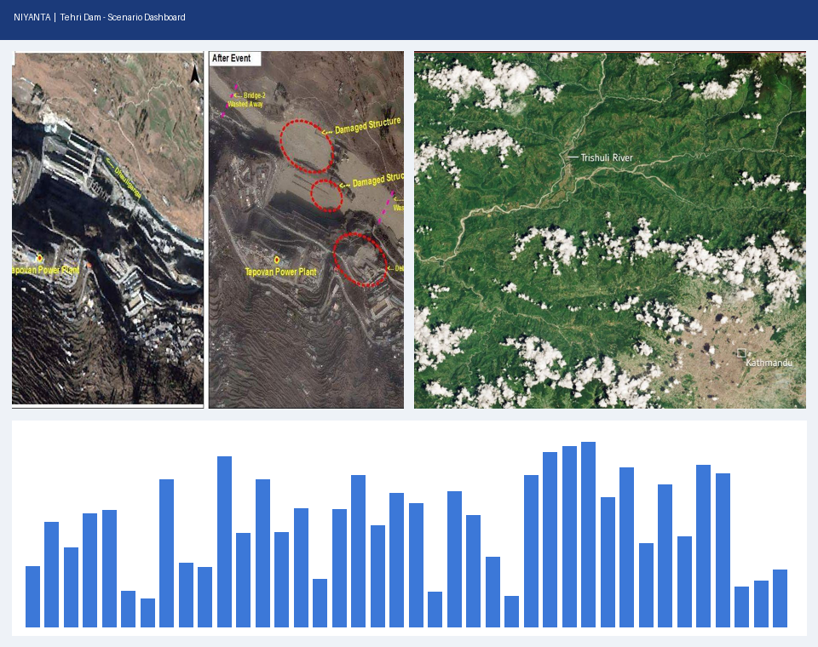




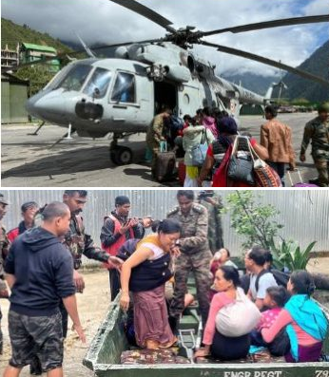
















NIYANTA
IMPACT AND BENEFITS
NIYANTA - From Early Warning to Safer India – Protecting People, Infrastructure, Environment and Economy
1
EMERGENCY RESPONSE & PREPAREDNESS
2
SYSTEM CAPABILITIES & INTEGRATION
3
VALIDATION & REAL-WORLD CASE STUDIES
Faster, targeted and data-driven action
Seamless data flow and automated decision support
Model output matched with actual incidents
Better Response
Preparedness
Satellite Data
(Sentinel-2 via GEE)
NIYANTA
AI Platform
1-Click Data Sharing
Across Departments
Rishi Ganga Incident Video
Model output matched with real-world incident data
80% – 90% accuracy
High-accuracy real-time data for disaster response organizations (like NDRF teams)
Faster and more targeted deployment
Reduces loss of life and injuries
Improved evacuation planning
NDRF
Weather &
Climate APIs
(Open-Meteo)
Ministry of Jal Shakti
▶ View Video
Ministry of Defence
Rishiganga, Uttarakhand (2021)
Historical Data
(Machhu Dam II, 1979)
Nepal Case Study Video
Operation Jal Rahat, Manipur 2025
State Governments
Real-world matched results
80% accuracy
AI 85% accuracy
Disaster & Defense
Planning
Offline
Repository
(pre/post event imagery)
Disaster Management Authorities
Proactive threat planning and impact area prediction
Helps in decision making before critical events or attacks occur (e.g., casualty and flooding estimations in the Bihar case)
Supports strategic infrastructure planning (dams, rivers, border regions)
Research & Academic Institutions
▶ View Video
Nepal flash flood – Sentinel-2 (ESA)
Automated Report Module
Flood Impact Report – Tehri Dam
Exposure & Validation
Kakhovka Incident Video
Impact & summary reports
Flood extent, depth, arrival
Casualty & exposure estimates
PDF · CSV · GIS (SHP/KML)
6.59 L m³/s
~1 h
Buildings (OSM)
1,592
Regional impact analysis and incident verification
Peak breach flow
First arrival
Road segments
998
Critical assets
126
~2.66 L
126
Downstream points
184
People exposed
Critical assets
Peak stage (m amsl) at 0 / 15 / 33 km
Scenario: overtopping • Solver: ANUGA 2D
Source: NIYANTA research paper (2026)
■ NIYANTA
▶ View Video
Army & IAF evacuation, Manipur 2025
Kakhovka Dam, Ukraine (2023)
KEY IMPACT NUMBERS (WITH SOURCES)
OVERALL IMPACT
Enhances
National Security
Protects
Environment & Ecology
Ensures
Economic Stability
Builds
Safe & Resilient Communities
97.5 M
6,138
40 M ha
42,105 MW
75%
People exposed to extreme floods yearly
Large dams; 1,289 are 50+ years old
Flood-prone land (1/8th of India)
Hydropower built (145 GW potential)
Districts are climate hotspots
15 M people exposed to glacial-lake floods; India in top 4
6,353 km² of Third Pole land at glacial-flood risk
₹25,805 cr average yearly flood damage (2011–21)
638 M people live in climate-hotspot districts
Source: CEEW (2020)
Source: NRLD 2023
Source: RBA via PIB
Source: CEA via PIB
Source: CEEW (2020)
Source: Taylor et al., Nat. Commun. 2023
Source: Zhang et al., Nat. Commun. 2023
Source: CWC data via FACTLY
Source: CEEW (2020)

Slide 5
















NIYANTA
FEASIBILITY AND VIABILITY
NIYANTA - Performance depends on hardware. How each specification changes simulation speed, scale and deployment.
1
SPECIFICATION → PERFORMANCE IMPACT
2
RESOLUTION vs RUNTIME
Component
Recommended spec
What it drives
How it changes performance
Source
Same 1 M-particle dam break (1.5 s simulated)
GPU
NVIDIA CUDA GPU (RTX-class)
Near-field SPH (DualSPHysics)
1 M particles: 6 h on 8 CPU cores → 15 min on 1 GPU
Crespo 2015
8-core CPU
6 h
VRAM
8 – 24 GB
Max. SPH particles
≈ 6 M particles / GB → 8 GB ≈ 48 M, 24 GB ≈ 145 M
Domínguez 2022
1 GPU
15 min ~24× faster
Crespo 2015
CPU cores
8 – 16 cores
2D routing (Delft3D / ANUGA, MPI)
Mesh split across cores (MPI); runtime grows with resolution
ANUGA docs
2D flood (Delft3D / ANUGA)
Grid ÷2 → cells ×4, steps ×2
≈ 8× runtime
3D SPH (DualSPHysics)
Spacing ÷2 → particles ×8, steps ×2
≈ 16× runtime
RAM
32 – 64 GB
DEM, mesh & rasters
Memory access is the bottleneck; more RAM = larger meshes
C-DAC 2021
Our design: SPH only near the breach, Delft3D / ANUGA on the 30 m DEM downstream
Storage
NVMe SSD, 1 TB
Offline data + outputs
Particle data saved often; faster disk = less waiting
DualSPHysics wiki
Rule of thumb from the CFL stability condition
3
HARDWARE TIERS what each setup can run
Laptop (CPU only)
GPU Workstation
HPC / Multi-GPU
OUR CURRENT BUILD
RECOMMENDED
NATIONAL SCALE
Multi-core laptop, no GPU
1× NVIDIA GPU (8–24 GB) · 8–16 cores · 32–64 GB RAM
Multi-GPU nodes linked with MPI (e.g. C-DAC)
DualSPHysics benchmark: PASS
Reduced-scale Tehri SPH (~15.5k particles)
Delft3D / ANUGA routing on the 30 m DEM
Full-head Tehri SPH (196 m head)
~48–145 M particles, set by VRAM
Delft3D / ANUGA in parallel on all cores
> 1,000 M particles (multi-GPU SPH)
Many dams & scenarios in parallel
Basin-wide / state-wide planning
Domínguez 2022
Domínguez 2022
4
FEASIBILITY WORKFLOW where each specification is used
Input data
DEM, rivers, dam data
Near-field SPH
DualSPHysics breach flow
Downstream routing
Delft3D / ANUGA 2D
Visualisation
3D terrain + 2D map
Automated report
PDF · CSV · GIS export
Uses: SSD
Uses: GPU + VRAM
Uses: CPU cores + RAM
Uses: GPU (WebGL)
Uses: CPU
5
OFFLINE DEPLOYMENT runs after one-time data download
6
WHY NIYANTA IS FEASIBLE
Local data
Checksummed datasets
Local models
SPH + Delft3D / ANUGA
Local compute
Own CPU / GPU
Local reports
Maps + PDF/CSV/GIS
Open-source solvers (SPH, Delft3D, ANUGA)
Scales to HPC for national use
Free, checksummed open data
Benchmark PASS · 22/22 tests
Runs on one GPU workstation
Peak flow matches Tehri study

Slide 6


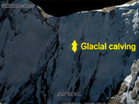
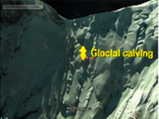
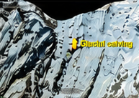
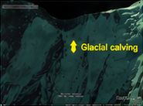
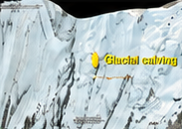
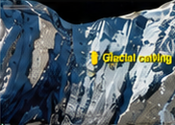
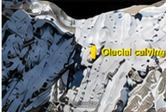
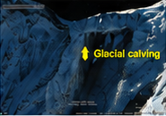









NIYANTA
RESEARCH AND REFERENCES
NIYANTA - Built on published research. Every model, number and result traceable to a source.
1. KEY RESEARCH REFERENCES
MULTISPECTRAL SATELLITE OBSERVATIONS: GLACIAL CALVING (2003 – 2021)
Madamsetty, R., Praveen, T.V., Surya Rao, S., & Manjula Vani, K. (2010). Tehri Dam-Breach Versus Monsoon Flood Routing in the Ganga River System. ISH Journal of Hydraulic Engineering, 16(1), 109–131. https://doi.org/10.1080/09715010.2010.10514992
Crespo, A.J.C., Domínguez, J.M., Rogers, B.D., et al. (2015). DualSPHysics: Open-source parallel CFD solver based on Smoothed Particle Hydrodynamics (SPH). Computer Physics Communications, 187, 204–216. https://doi.org/10.1016/j.cpc.2014.10.004
Froehlich, D.C. (2008). Embankment Dam Breach Parameters and Their Uncertainties. Journal of Hydraulic Engineering, ASCE, 134(12), 1708–1721. https://doi.org/10.1061/(ASCE)0733-9429(2008)134:12(1708)
Kernkamp, H.W.J., van Dam, A., Stelling, G.S., & de Goede, E.D. (2011). Efficient scheme for the shallow water equations on unstructured grids (Delft3D Flexible Mesh). Ocean Dynamics, 61, 1175–1188. https://doi.org/10.1007/s10236-011-0423-6
Roberts, S., Nielsen, O., Gray, D., & Sexton, J. ANUGA User Manual. Geoscience Australia & ANU. https://github.com/GeoscienceAustralia/anuga_core
Geospatial Investigation of the Rishiganga Disaster in Uttarakhand, India (2024). ResearchGate – publication 382327177
Recent Debris-Flow and Glacial Lake Outburst Studies. https://www.sciencedirect.com/science/article/pii/S2667010021003759
Global Dam Failure Case Studies and Database. https://damfailures.org/
(a) 2003
(b) 2005
(c) 2012
(d) 2013
(e) 2014
(f) 2015
(g) 2018
(h) 2021
Source: ResearchGate (2024) – Rishiganga Study
COMPARISON WITH TRADITIONAL SYSTEMS
IS OUR BREACH FLOW CORRECT?
Feature
Traditional Methods & Existing Studies
Our Solution: NIYANTA
Cross-checked peak discharge at Tehri Dam
• Same order as the only published Tehri study (ratio 0.67). First run was 5.8× too high – our own cross-check found the depth bug and we fixed it.
Breach & Flow Physics
Empirical breach + 1D routing (e.g. NWS-FLDWAV); channel width assumed from regime theory.
SPH near-field (DualSPHysics) + 2D Delft3D / ANUGA routing over the real Copernicus 30 m DEM of the Bhagirathi valley.
Model
Breach Method
Peak Q at dam (m³/s)
NIYANTA (fixed)
Froehlich (2008) + Fread (1988)
OUR RESULT
Data & Transparency
Often proprietary software and gaps filled with unstated guesses.
Free open data, checksummed; every input labelled OBSERVED / HYPOTHETICAL / UNAVAILABLE.
659,056
Maddamsetty et al. (2010)
NWS-BREACH physical erosion
980,324
Scope & Outcome
Static PDF flood maps; no link to people or assets at risk.
Arrival time at 1–12 h, exposure (~2.66 lakh people, 126 assets), 3D/2D dashboard + GIS export.
Froehlich (1995)
Peak-outflow regression
≈3.9 lakh
RESEARCH TO DEPLOYMENT WORKFLOW
Literature Study
(Tehri, SPH, GLOFs)
Multispectral Analysis
(2003–2021)
SPH Benchmark
(PASS)
Delft3D / ANUGA Run
(Validation)
MVP Dashboard
(Working)
Finalizing the
Software
Deploy & Host
(Offline)

Slide 9
NIYANTA
IDEA TITLE

Slide 10
NIYANTA
IDEA TITLE

Slide 11
NIYANTA
IDEA TITLE

Slide 12
NIYANTA
IDEA TITLE

